Slide 1
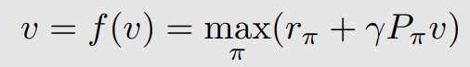
值迭代&策略迭代
最优Belman方程
最优Belman方程
求解v：迭代更新
Value Iteration
Police Iteration
Truncated Policy Iteration
value update <->policy update
假设：环境模型已知
model-based RL Algorithm

Slide 2
Model-based RL
Value iteration algorithm
Policy interaction algorithm
Truncated policy interaction algorithm

Slide 3
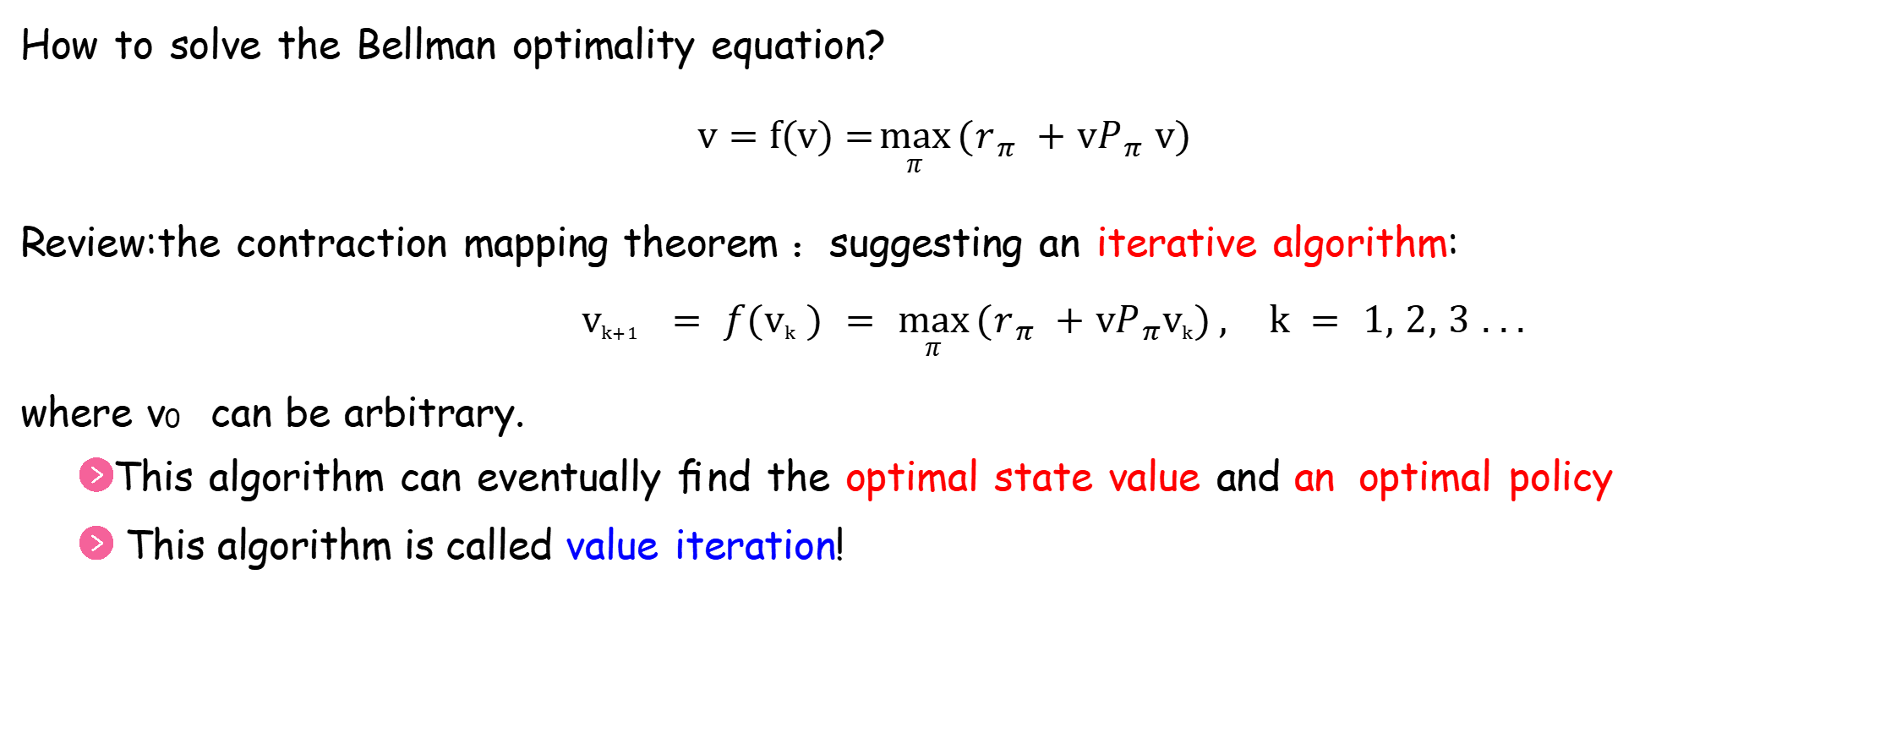

Value iteration algorithm
How to solve the Bellman optimality equation?
$$v=f(v)=\max_{π}{(r_{π} +vP_{π} v)}$$
Review:the contraction mapping theorem ：suggesting an iterative algorithm:
$$v_{k+1} = f(v_{k} ) = \max_{π}{(r_{π} +vP_{π}v_{k})}, k = 1, 2, 3 . . .$$
where v₀ can be arbitrary.
This algorithm can eventually ﬁnd the optimal state value and an optimal policy
This algorithm is called value iteration!

Slide 4
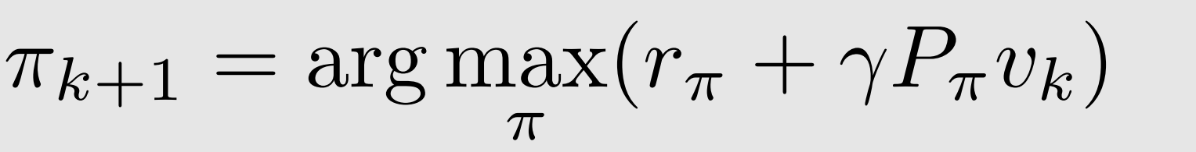
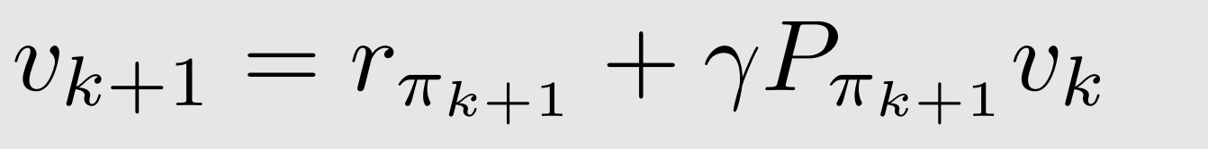
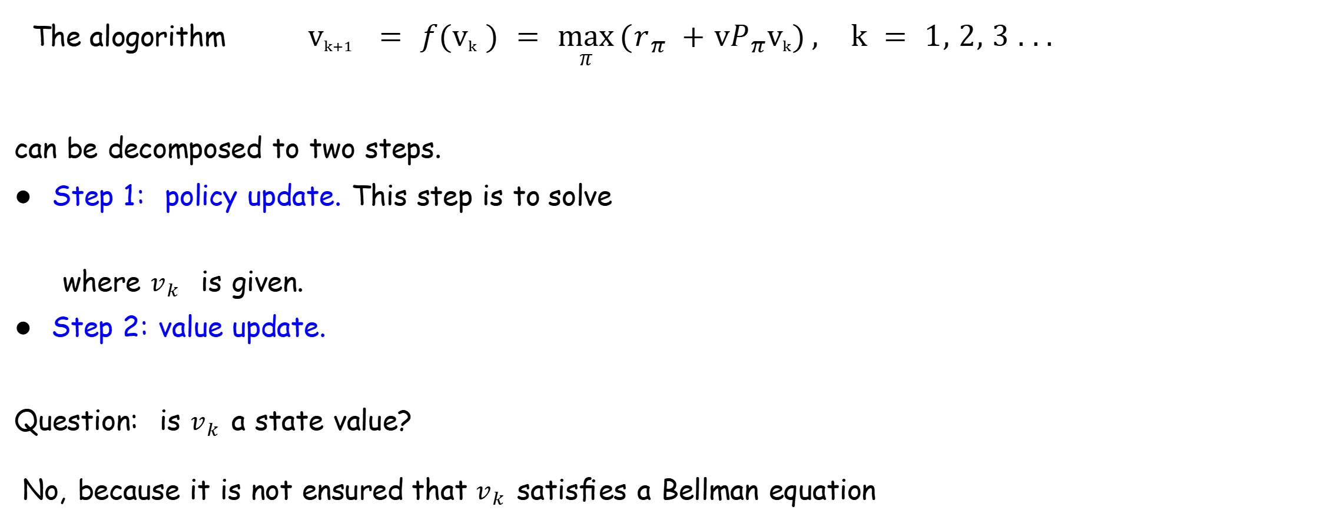
Value iteration algorithm
Matrix-vector form
useful for theoretical analysis.
The alogorithm $v_{k+1} = f(v_{k} ) = \max_{π}{(r_{π} +vP_{π}v_{k})}, k = 1, 2, 3 . . .$
can be decomposed to two steps.
● Step 1: policy update. This step is to solve
where $v_{k}$ is given.
● Step 2: value update.
Question: is $v_{k}$ a state value?
No, because it is not ensured that $v_{k}$ satisﬁes a Bellman equation

Slide 5
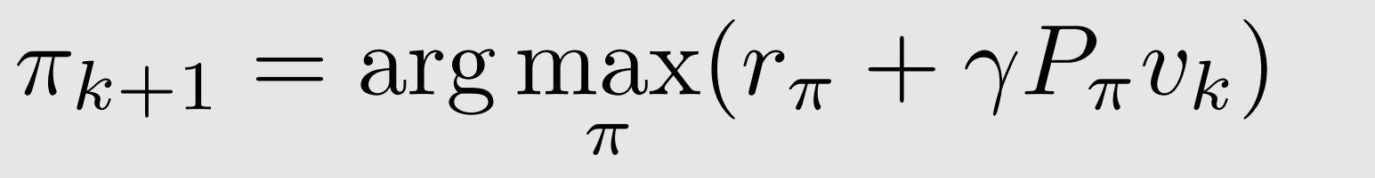
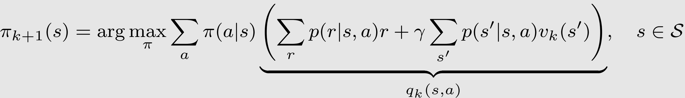
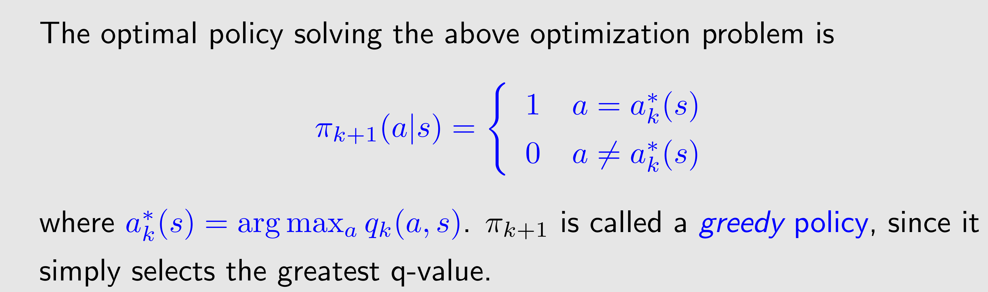
Value iteration algorithm
Elementwise form
useful for implementation
● Step 1: policy update. The elementwise form of
=>

Slide 6
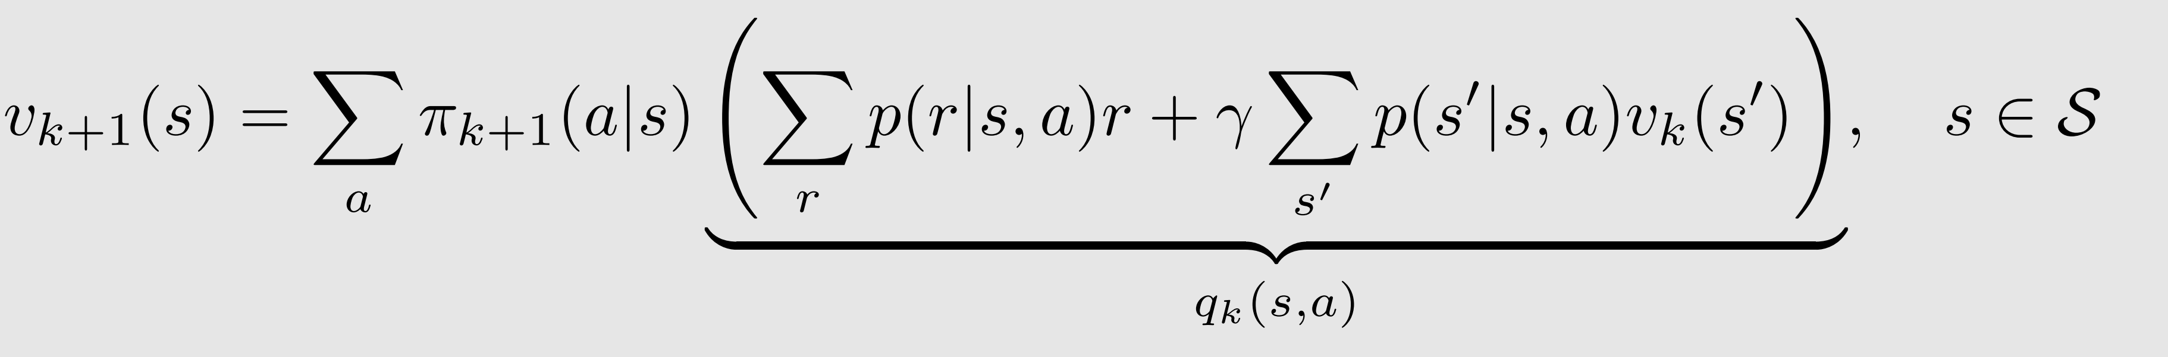
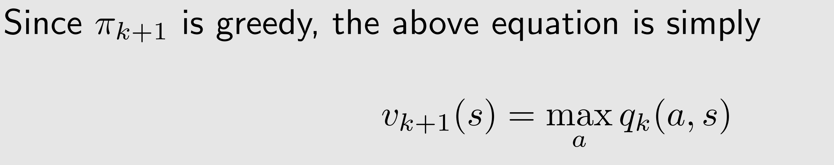
Value iteration algorithm
Elementwise form
useful for implementation
The elementwise form of
● Step 2: value update.
=>

Slide 7
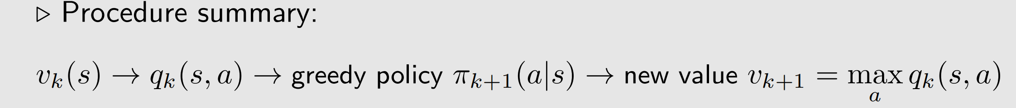
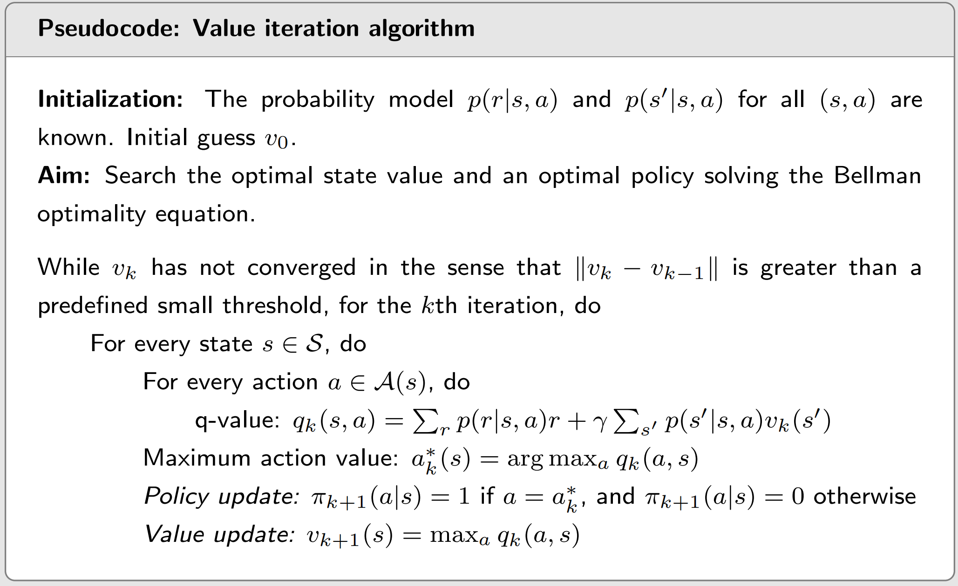
Value iteration algorithm - Pseudocode

Slide 8
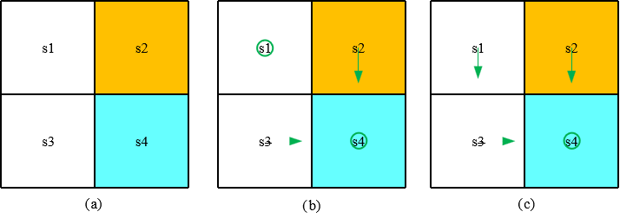
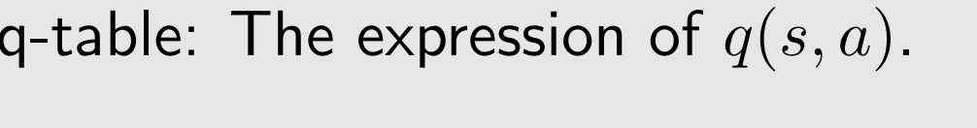
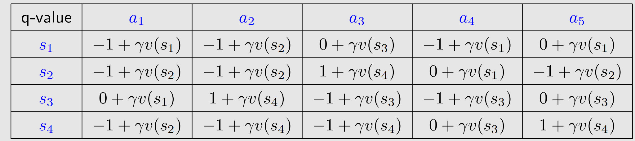
Value iteration algorithm - Example

Slide 9
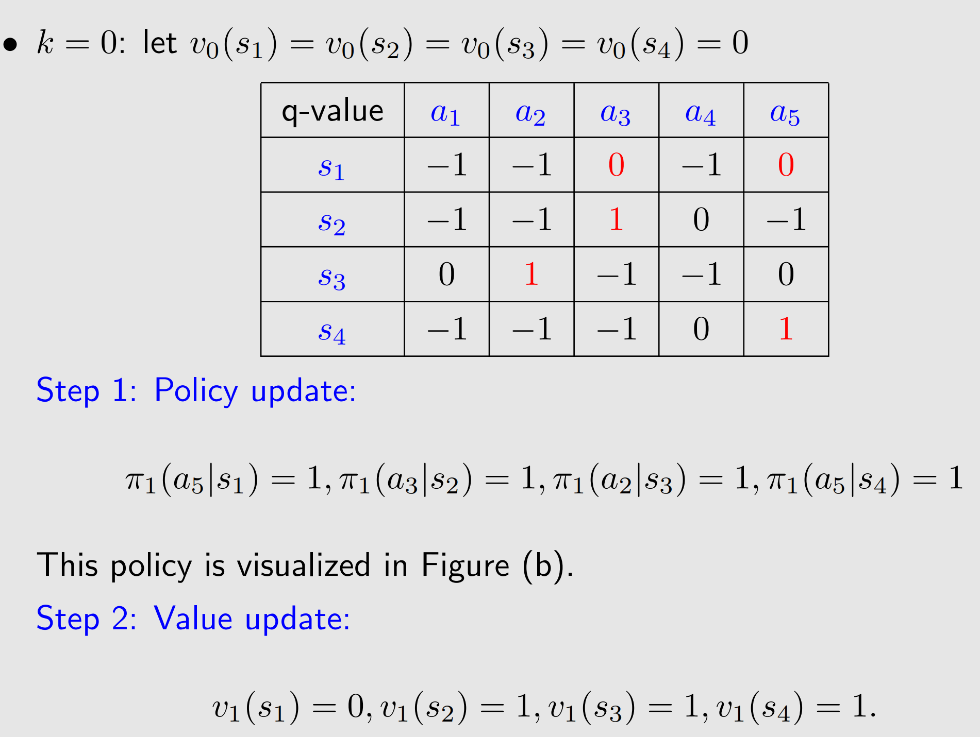
Value iteration algorithm - Example

Slide 10
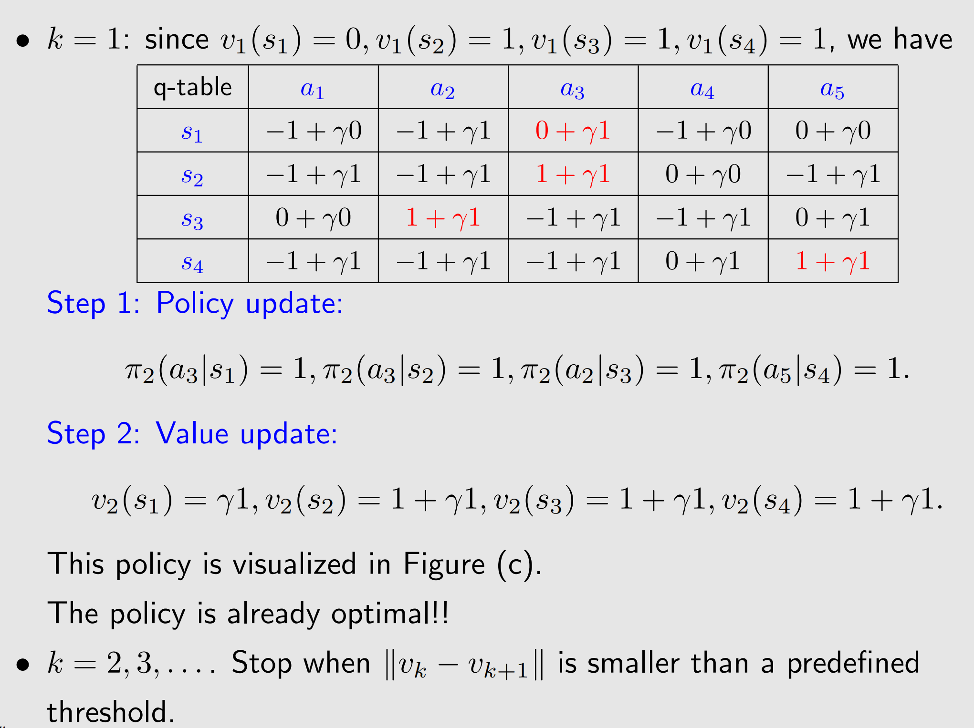
Value iteration algorithm - Example

Slide 11
Value iteration algorithm - Example

Slide 12
值迭代与策略迭代
01
Value iteration algorithm
02
Policy iteration algorithm
03
Truncted policy iteration algorithm

Slide 13
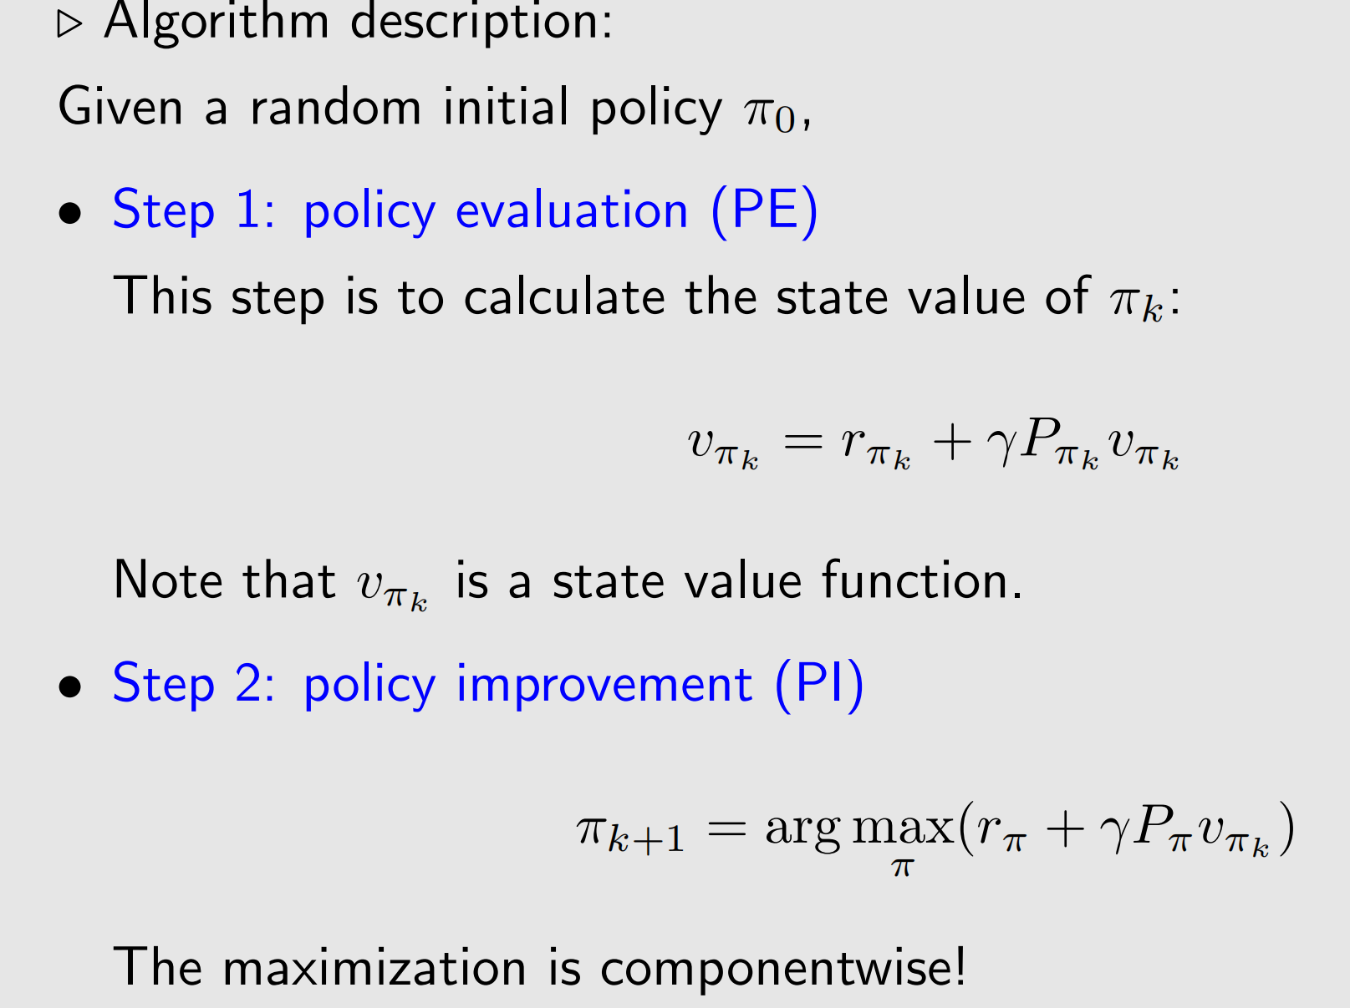
Policy iteration algorithm

Slide 14
Policy iteration algorithm

Slide 15
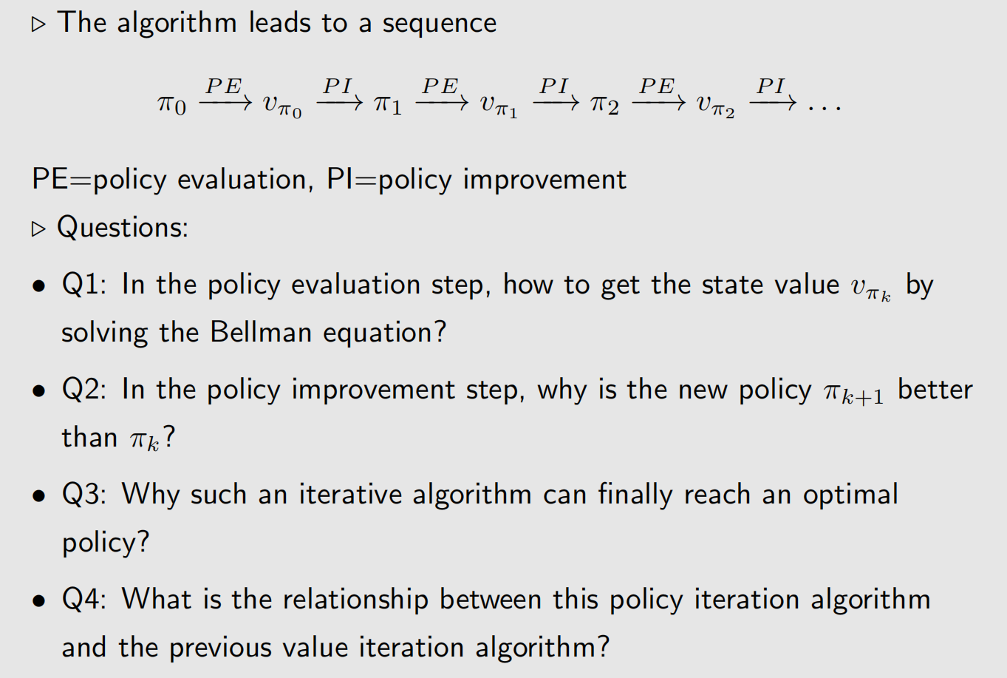
Policy iteration algorithm

Slide 16
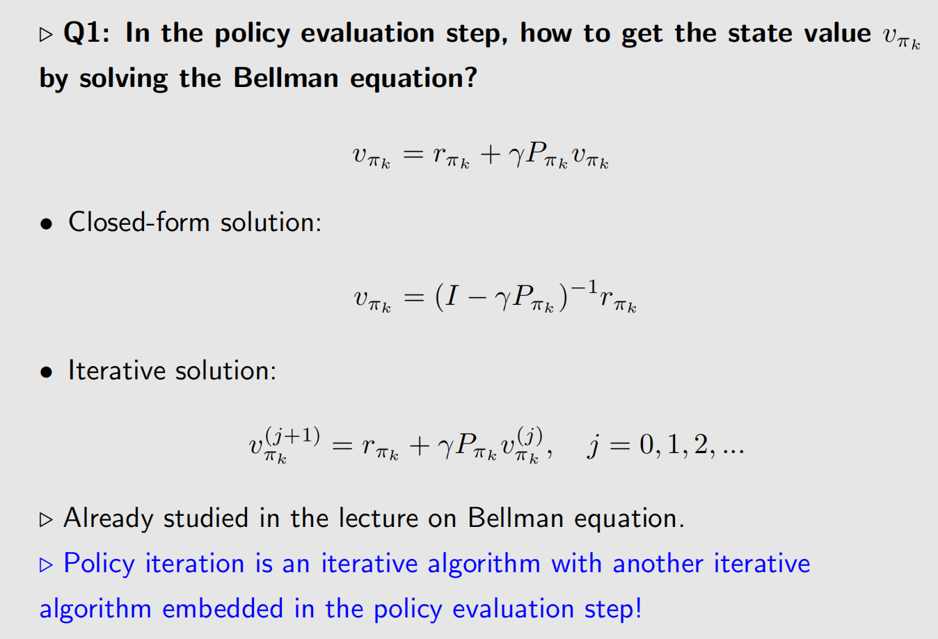
Policy iteration algorithm

Slide 17
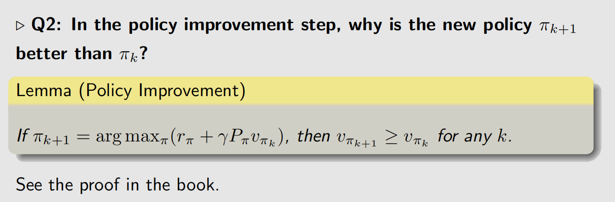
Policy iteration algorithm

Slide 18
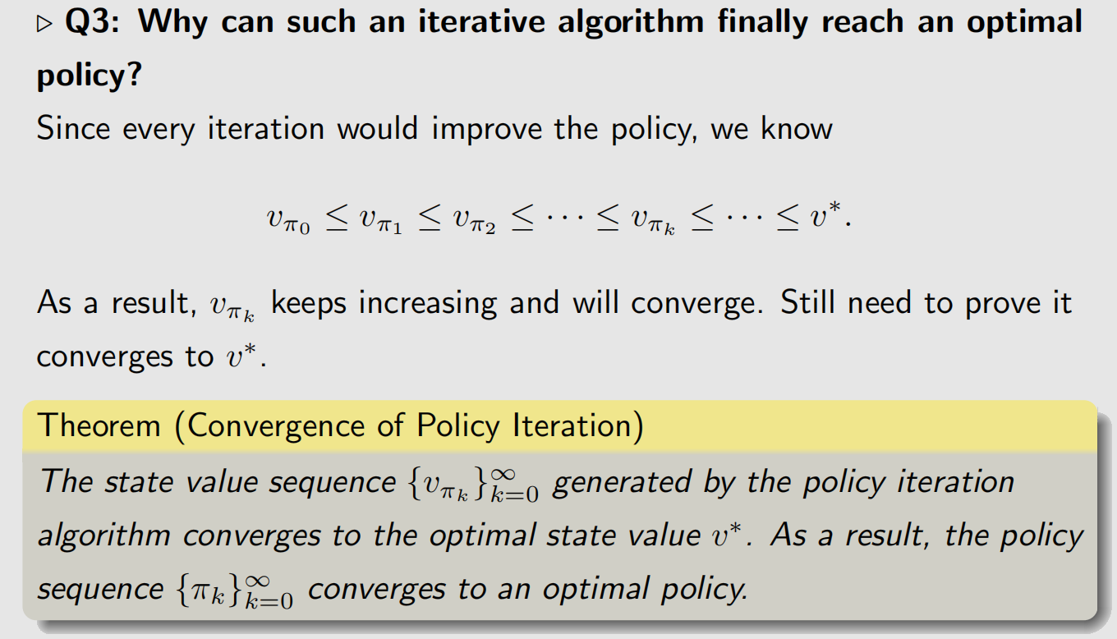
Policy iteration algorithm - Example

Slide 19
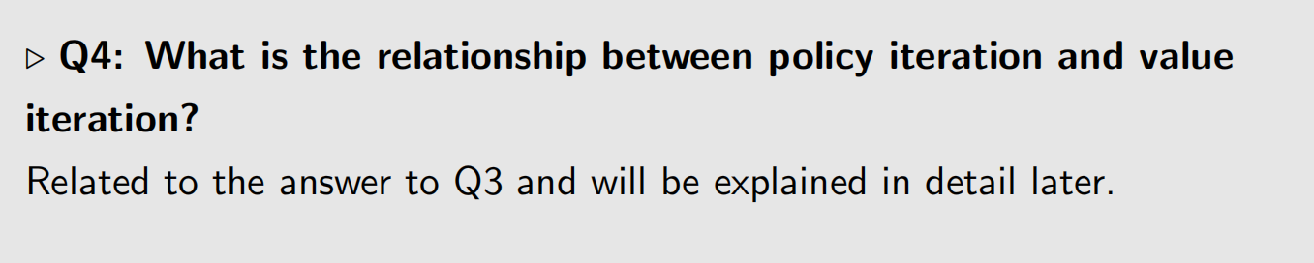
Policy iteration algorithm

Slide 20
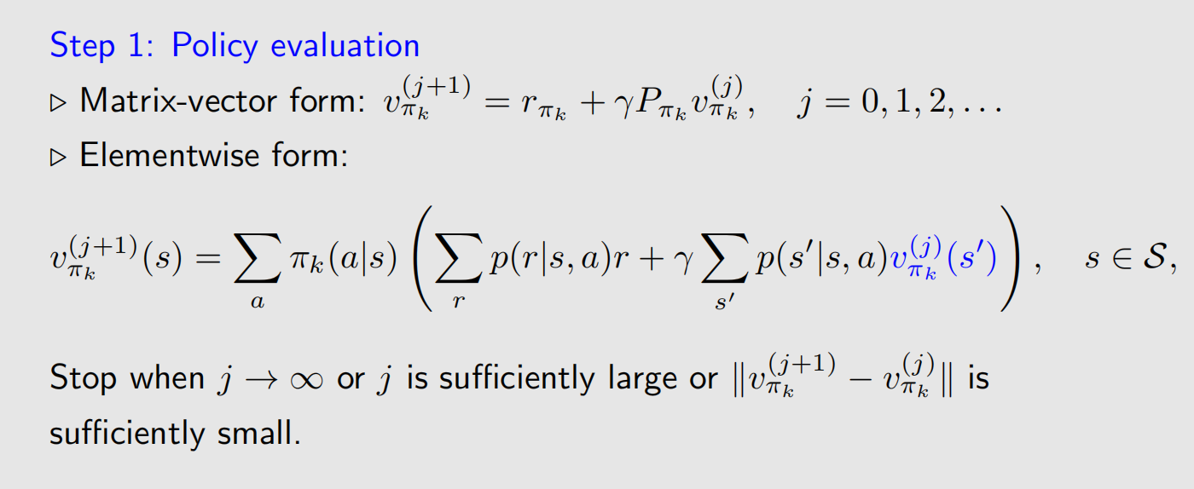
Policy iteration algorithm - Elementwise form

Slide 21
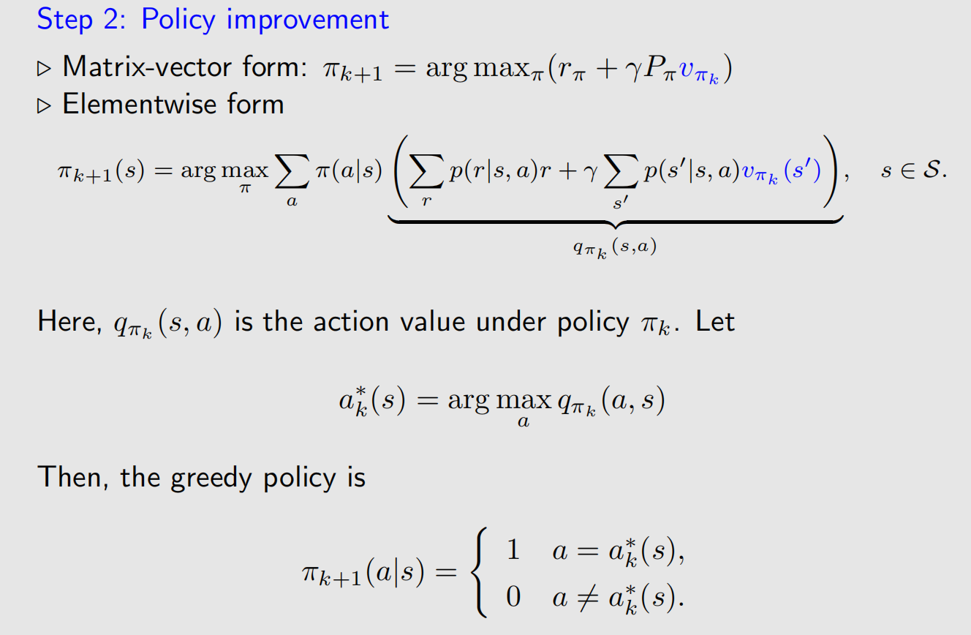
Policy iteration algorithm - Elementwise form

Slide 22
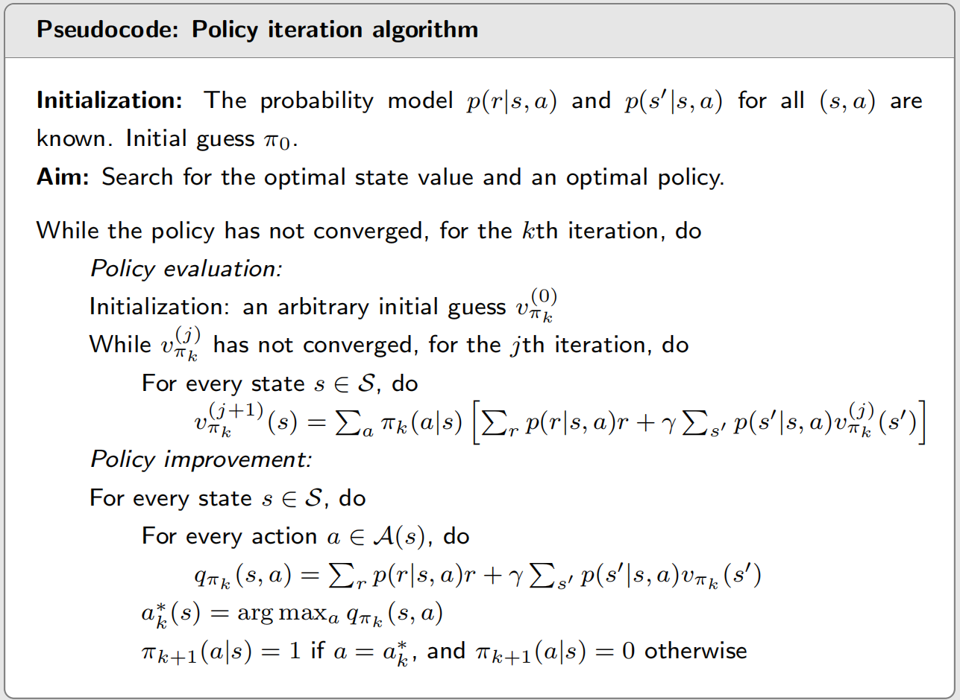
Policy iteration algorithm - Implementation

Slide 23
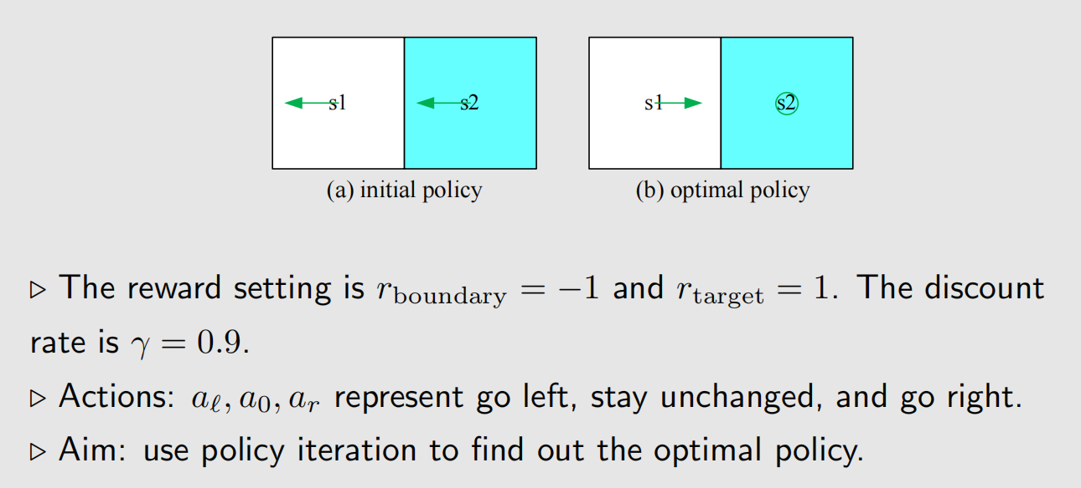
Policy iteration algorithm - example

Slide 24
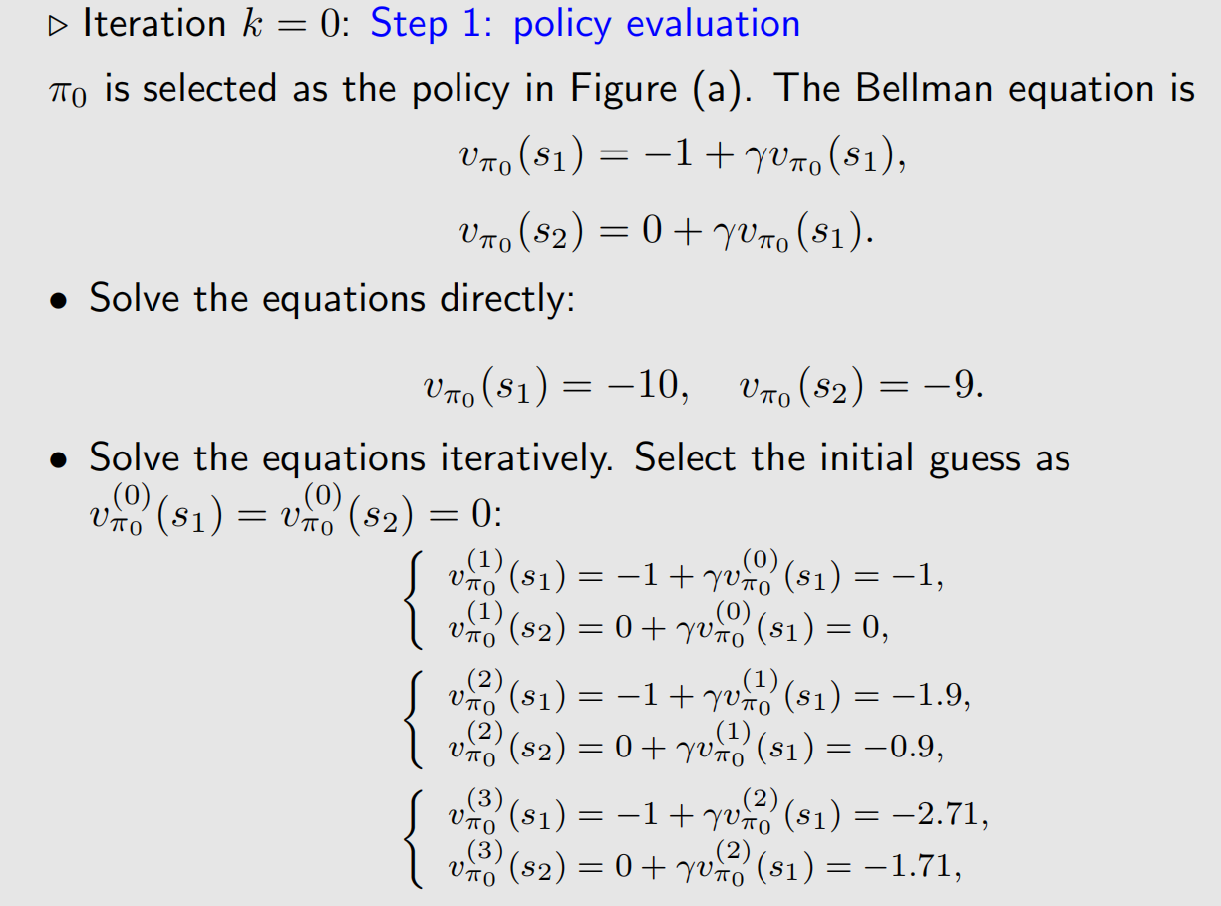
Policy iteration algorithm - example

Slide 25
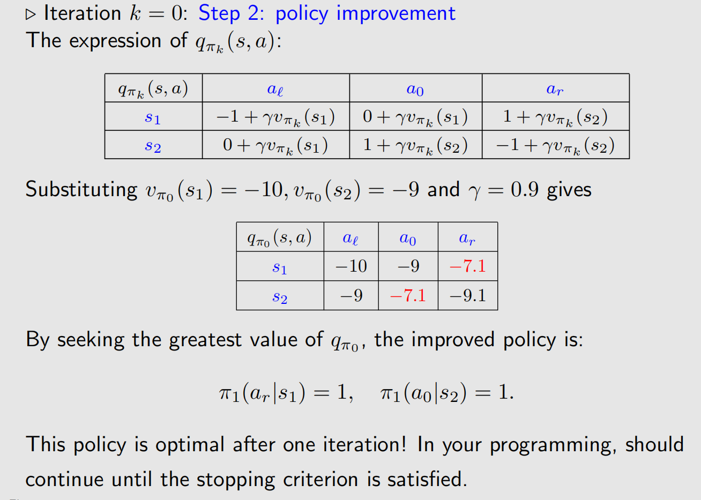
Policy iteration algorithm - example

Slide 26
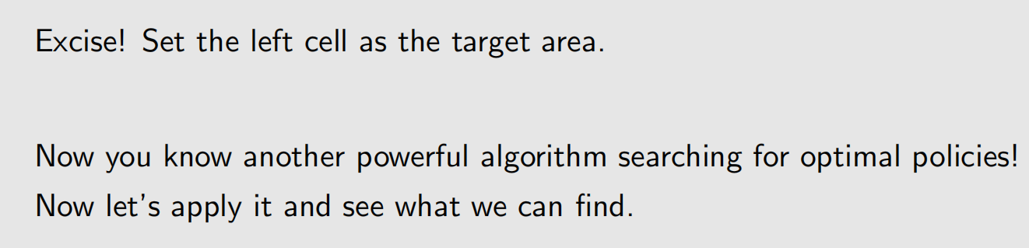
Policy iteration algorithm - example

Slide 27
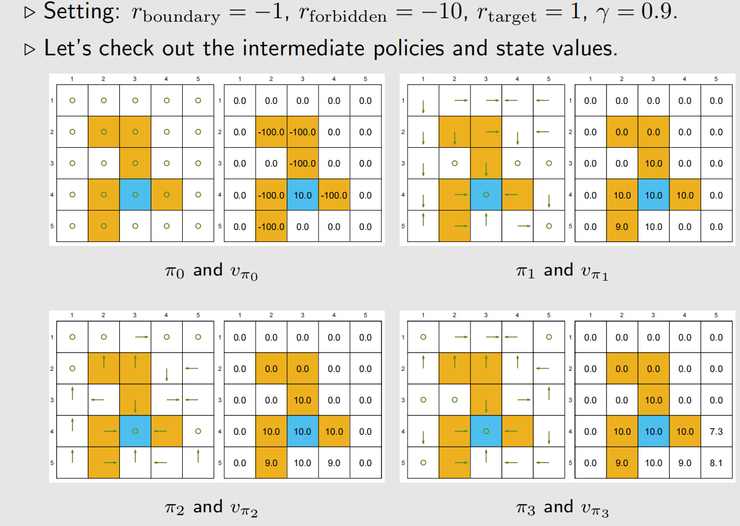
Policy iteration algorithm - example 2

Slide 28
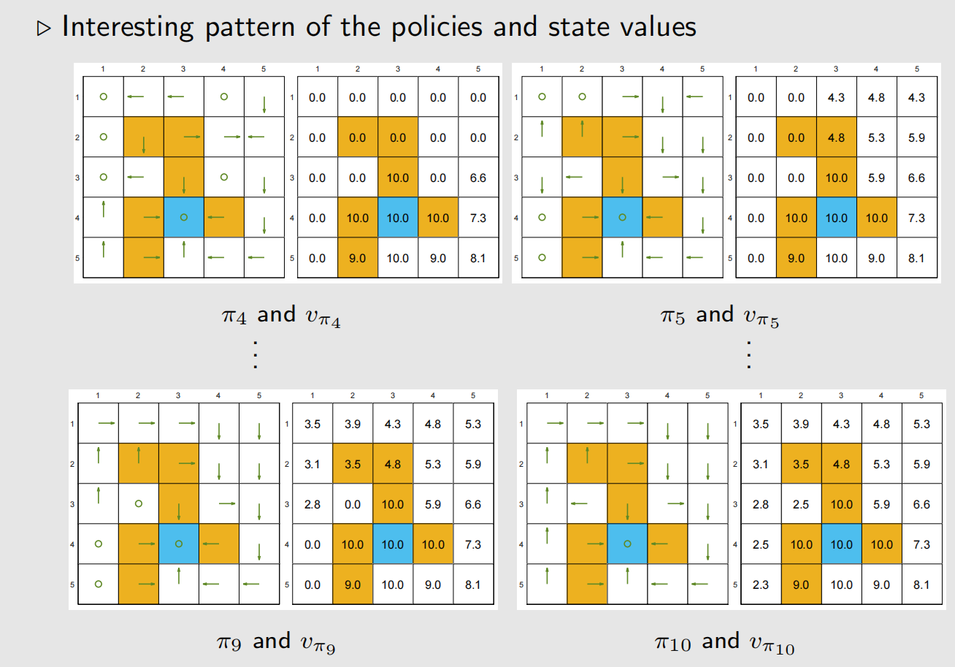
Policy iteration algorithm - example 2

Slide 29
值迭代与策略迭代
01
Value iteration algorithm
02
Policy iteration algorithm
03
Truncted policy iteration algorithm

Slide 30
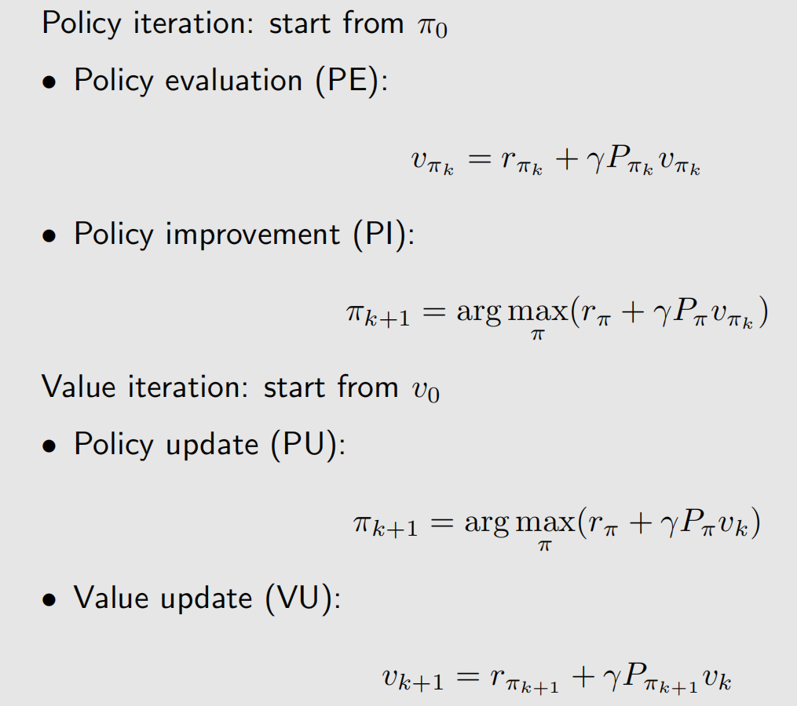
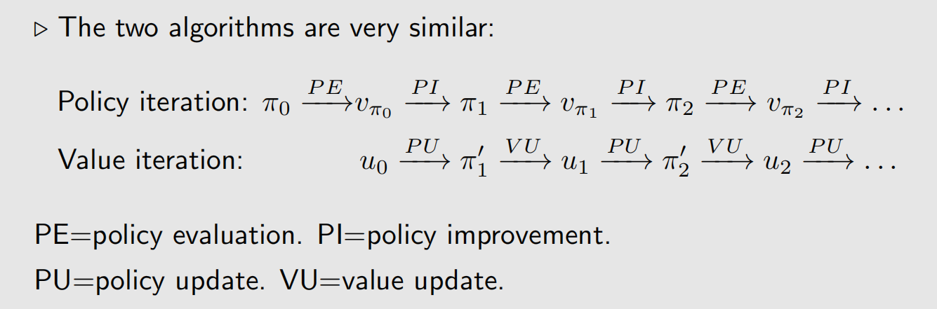
Compare value iteration and policy iteration

Slide 31
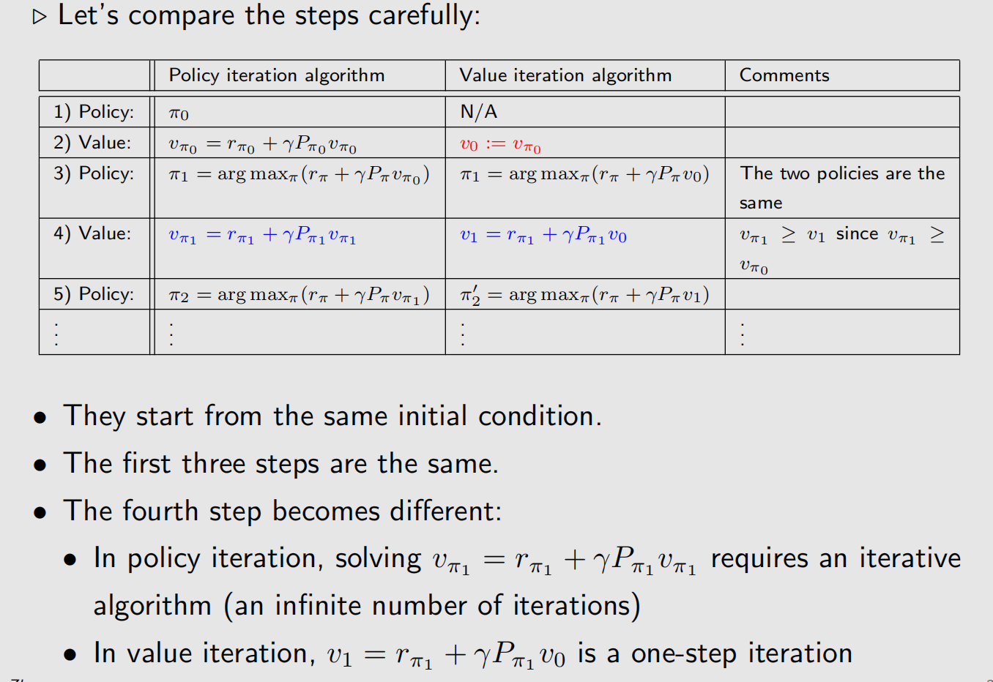
Compare value iteration and policy iteration

Slide 32
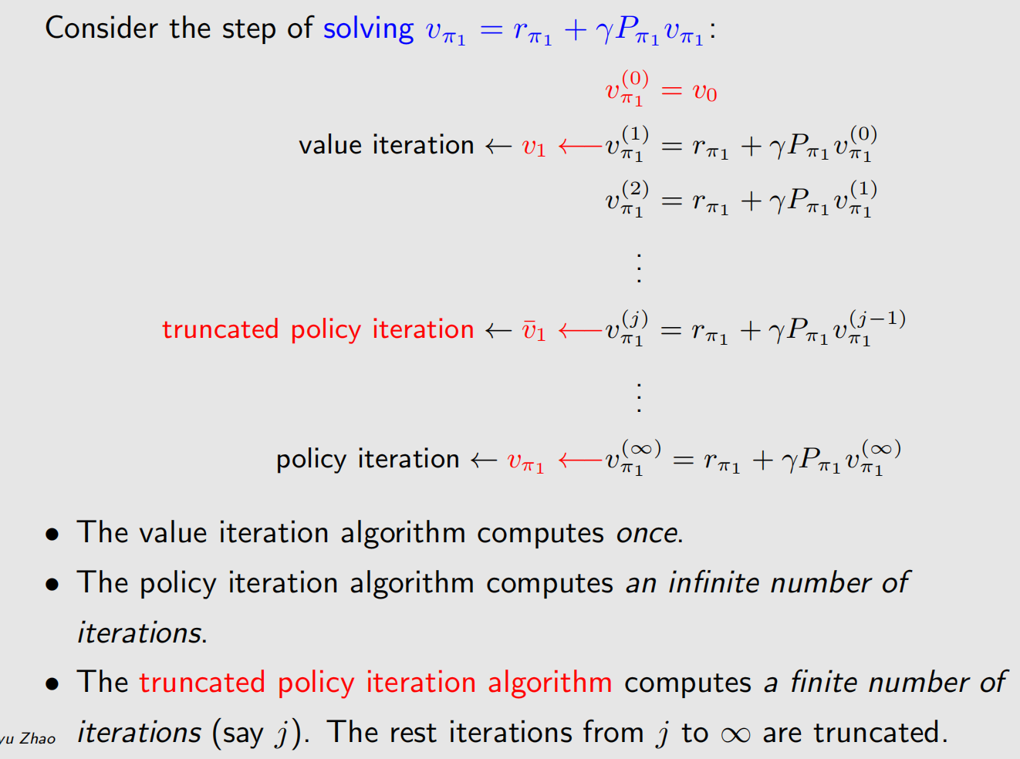

Compare value iteration and policy iteration

Slide 33
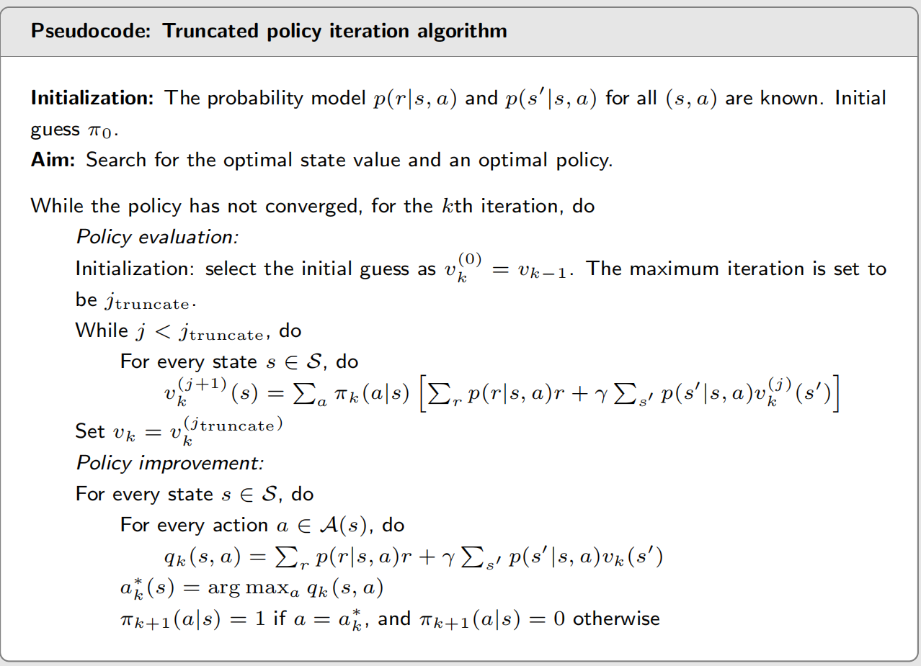
Truncated policy iteration - Pseudocode

Slide 34
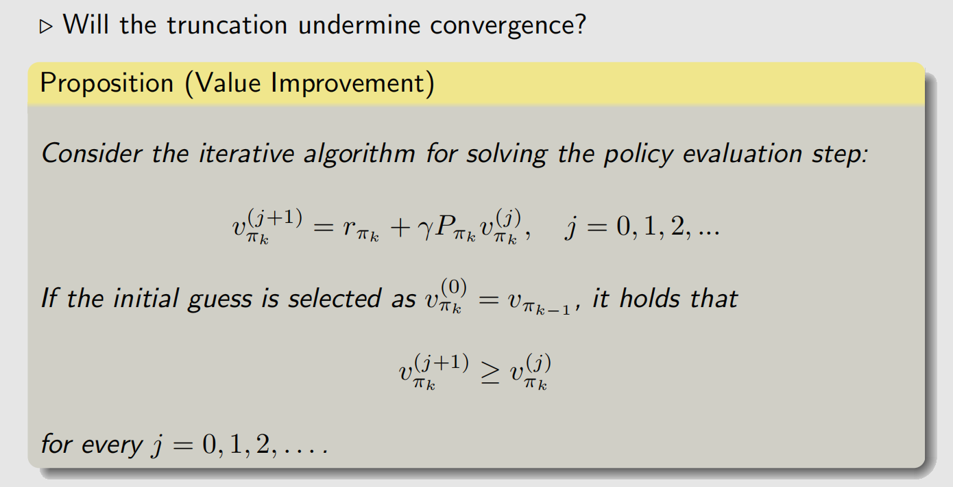
Truncated policy iteration - Convergence

Slide 35
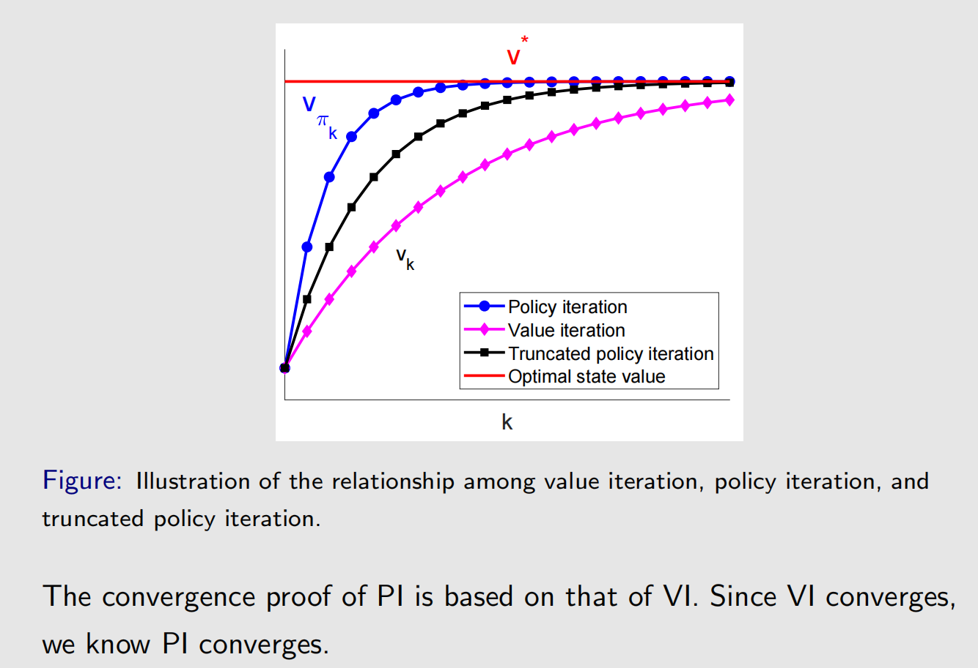
Truncated policy iteration - Convergence

Slide 36
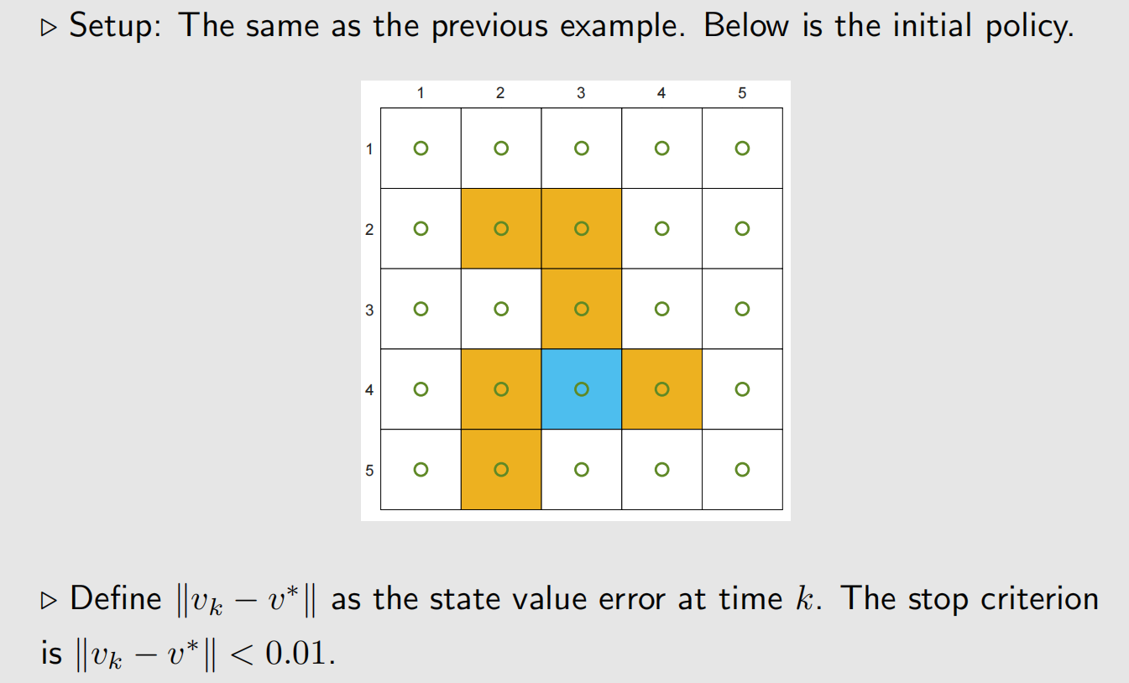
Truncated policy iteration - Example

Slide 37
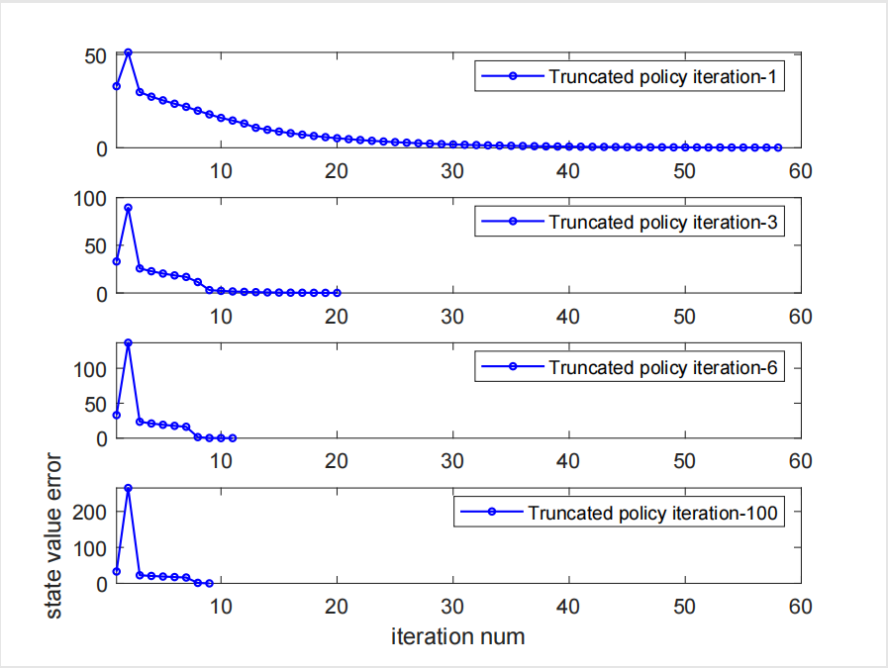

Truncated policy iteration - Example
.
“Truncated policy iteration-x” where x = 1, 3, 6, 100 refers to a truncated policy iteration algorithm where the policy evaluation step runs x iterations.

Slide 38
Truncated policy iteration - Example
.
The greater the value of x is, the faster the value estimate converges.
However, the benefit of increasing x drops quickly when x is large.
In practice, run a few number of iterations in the policy evaluation step.

Slide 39
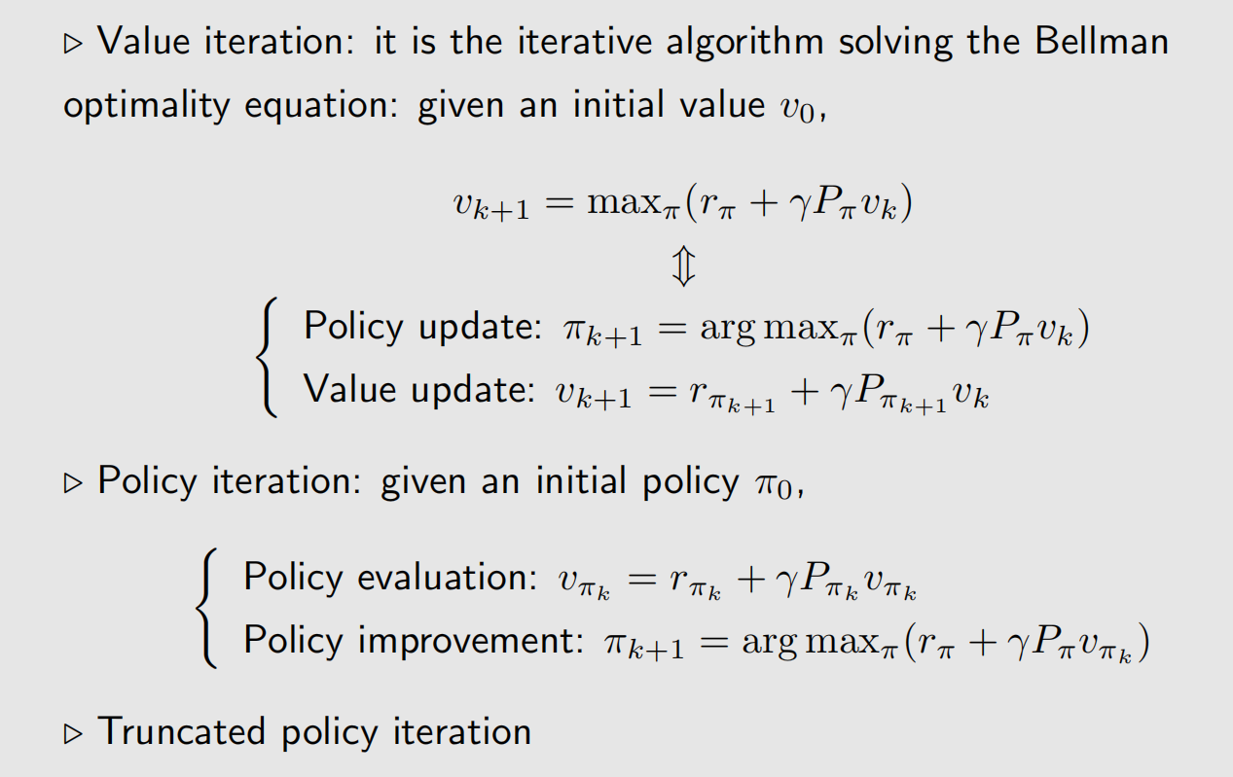
Summary

